Slide 1
Session 26
Reinforcement Learning
Unsupervised Learning
Clustering
Naïve Bayes Models (e.g., Autoclasses)
K-Means Clustering Algorithm
The EM algorithm
Learning POMDP from experience (ALFE 4-5)
EM: the Crown-Jewel of Machine Learning !!!
I am so proud that you are learning this ☺

Slide 2

What You Learn in This Class?
Learn AI and ML
Learn how to learn by yourself
EM Algorithm
Machine Learning
Probability Reasoning
Knowledge Representation
General AI

Slide 3
Reinforcement Learning (RL) Recap MDP vs RL
A Markov Decision Process consists of
A set of states S (with an initial state s₀)
A set of actions A in each state, a set of percepts that can be sensed
A transition model P(s’|s,a), or T(s,a,s’), a current state distribution
A reward function R(s,a,s’)
The MDP’s solution identifies the best action to take in each state
Optimal policy π(s)=a obtained by value iteration or policy iteration (aka dynamic programming)
What do we do if we only know the states S and actions A, but not the transition model T(s,a,s’) and/or reward R(s,a,s’)?
Don’t know if a state is rewarding or punishing i.e. no Value/Utility U(s)
Don’t know which action will lead to a rewarding state
Reinforcement learning tries different actions in states to discover π(s)=a

Slide 4
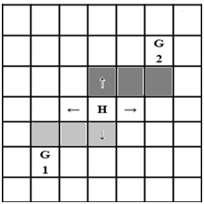
Exploring the State Space
Visit different states to discover a policy and improve it
Numerous strategies
A simple strategy is executing actions randomly
Initially there is no policy, but random actions eventually discover a policy
At every time step, act randomly with a probability, else follow current policy
Causes unnecessary action execution when the optimal policy is discovered
One solution is to lower the probability of selecting a random action over time

Slide 5
Reinforcement Learning
Objective: Learn optimal policy π(s)=a
Model-based RL
Learn the model first, then the policy
Model-free RL
Learn the policy w/o learning an explicit model
Monte Carlo
Temporal Difference
Q-Learning

Slide 6
Model-Based RL
Learn an approximate model based on random action execution
Count outcomes of s’ for each s, a
Normalize to give an estimate of T(s,a,s’)
Propagate rewards when they are encountered to discover R(s,a,s’)
Solve the learned MDP and obtain a policy
Pros:
If the goal changes, use the learned T(s,a,s’) to recalculate U(s) and compute a new policy offline
Cons:
Larger representation than model-free RL

Slide 7
Monte Carlo RL
Generate a fixed policy π(s)=a
In each episode the learner simply follows the policy starting at a random state
Average the sampled returns originating from each state
Generate a new policy based on U(s), repeat as in policy iteration
Cons:
Works only in episodic problems
Takes very long to converge as learning is from complete sample returns
Wastes information as it figures out state values in isolation from other states
1
2
3
4

Slide 8
Temporal Difference RL
Improve Monte Carlo, still using a fixed policy
allow updates to U(s) each time a transition (s,a,s’,r) is experienced
Sample return or running average = R(s, a, s’) + γU(s’)
U(s) ← U(s) + α [sample – U(s)] where α=learning rate
U(s) ← U(s) + α [r + γU(s’) – U(s)] where γ=discount factor
U(s) ← (1- α) U(s) + (α) [sample]
Decreasing α converges the averages by forgetting the distant past values
Cons:
Only provides the utility of states, does not provide a new policy directly

Slide 9
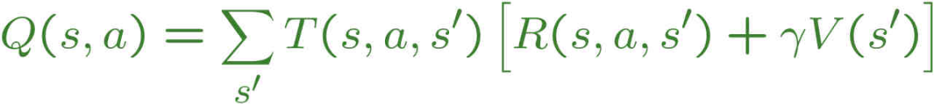
Q-Learning
Q(s,a) represents the value of taking an action in state s, rather than only the value U(s) = V(s)
Optimal π(s) = arg max U^{π} (s) = arg max_{a} Q(s,a)
Use running average of Q(s,a) since T and R are not known
No need a fixed policy, off-policy learning
Receive a sample (s,a,s’,r)
Initially Q₀(s,a) = 0
New sample estimate = Q(s,a) ≈ r + γ max_{a’} Q(s’,a’)
Compute running average Q(s,a) ← (1-α) Q(s,a) + α [sample]
Pros:
Provably convergent to optimal policy
Directly learns a policy without the overheads of a model

Slide 10
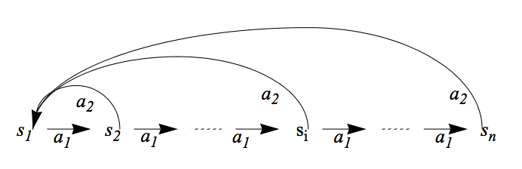
An Example Problem of Q-Learning
Given
States: s₁, …, s_{n}
Actions: a₁, a₂,
Rewards: all R(s_{i},a_{i})=0 except R(s_{n-1}, a₁)=100
The goal state is implicit
Learn:
State values V(s_{i}), and a policy π(s_{i})→a_{i}
Goal
100

Slide 11
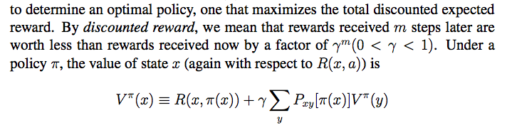
The Objective of Q-Learning
y₁
V(y₁)
V(x)
P(y|x,a)
s_{x}
y₂
V(y₂)
a=π(s_{x})
y_{l}
V(y_{j})

Slide 12
Pros & Cons of RL
Pros:
Easy to use in problems where the data can be mapped to states easily
Guaranteed to find the optimal policy given enough time even with suboptimal actions
Cons:
Computation time is intractable for large or continuous state spaces
E.g. if each cell in a grid world is a state, then state space grows exponentially with number of rows and columns (states = map size = m*n)
Cannot handle raw data, must use an approximation/reduction function
Designing approximation functions to disambiguate similar states requires human intelligence or an alternate learning technique
E.g. use the relative distance (states = m*n) between two agents in a hunter-prey problem as opposed to their cell coordinates (states = m*n*m*n)
Model-free RL cannot transfer the learned knowledge when the goal changes
Forgetting a learned policy is much more difficult (hysteresis), quicker to start from scratch

Slide 13
Unsupervised Learning (Clustering)
Type I: Clustering the data
Automatically group the data into clusters
Type II: Parameter Learning (states are known)
Learn transitions, sensor models, & current state
Type III: Structural Learning (future lectures)
States are unknown and must be automatically determined
States are not just a “symbol” but may have internal structures

Slide 14

Clustering
Clustering systems:
Unsupervised learning
Detect patterns in unlabeled data
E.g. group emails or search results
E.g. find categories of customers
E.g. detect anomalous executions
Useful when don’t know what you’re looking for
Requires data, but no labels
Often get gibberish but may have surprisingly good results
Mom, dad, strangers?

Slide 15
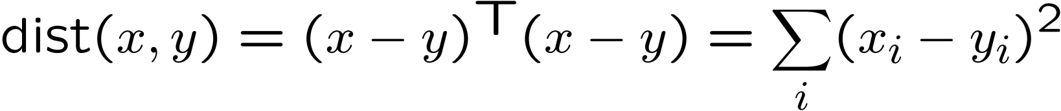
Clustering
Basic idea: group together similar instances
Example: 2D point patterns
What could “similar” mean?
One option: small (squared) Euclidean distance

Slide 16

An Example of “Clustering”
1.0, 3.0
101.0, 103.0
Given the four data points D above
Cluster them in one, two, three, or four clusters?
Let the hypothesis be H₁, H₂, H₃, H₄
Choose the H_{J} such that P(H_{J}|DX) is the highest
Where X is the background knowledge
Bayes Model
How well hypothesis explain data?
How likely is the data?
How likely is the hypothesis?

Slide 17
Different Hypotheses for Clustering (Assume Gaussian Distributions)
H₁
1.0, 3.0
101.0, 103.0
H₂
1.0, 3.0
101.0, 103.0
H₄
1.0, 3.0
101.0, 103.0

Slide 18
Clustering Algorithms
Naïve Bayes Model (AUTOCLASS)
K-Means
Agglomerative

Slide 19
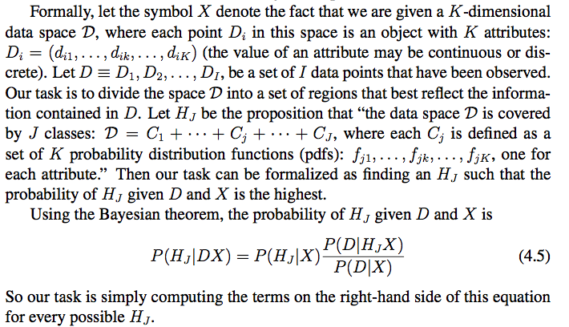
A Bayes Model
Example 1: data D = freshly caught fishes, cluster J = types of fishes
Example 2: data D = star observations, cluster J = type of stars

Slide 20
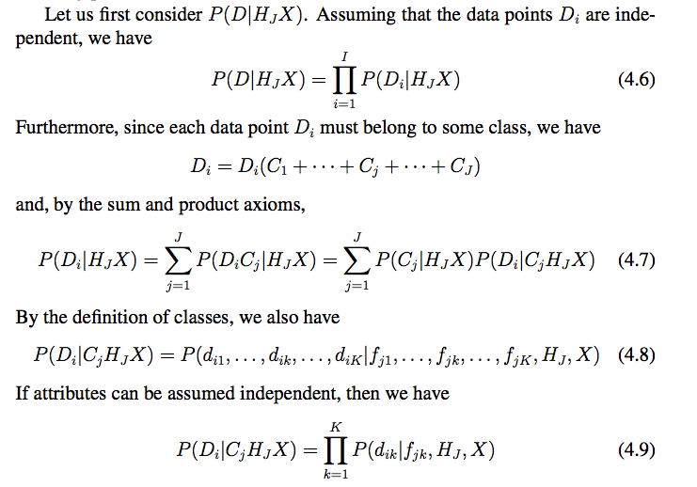
A Naïve Bayes Model
Naïve
Naïve
The Autoclass Clustering Algorithm

Slide 21
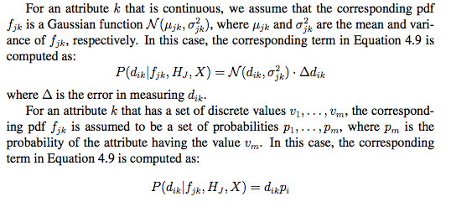
AUTOCLASS Algorithm

Slide 22
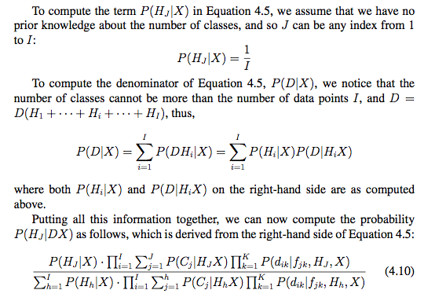
AUTOCLASS Algorithm

Slide 23


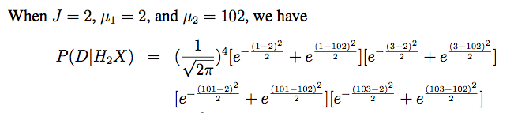


Back to the example
P(D|H₃X) = ……
Since P(X|H₂X) > P(X|H₃X) > P(X|H₄X) > P(X|H₁X), the Bayesian theorem tells that H₂ is the best hypothesis, which matches our intuition perfectly!

Slide 24
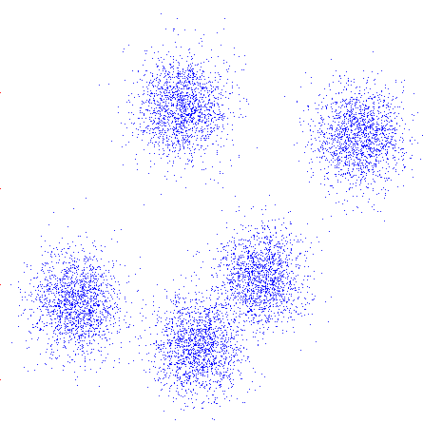
K-Means Clustering
An iterative clustering algorithm
Pick K random points as cluster centers (means)
Alternate:
Assign data instances to closest mean
Assign each mean to the average of its assigned points
Stop when no points’ assignments change

Slide 25
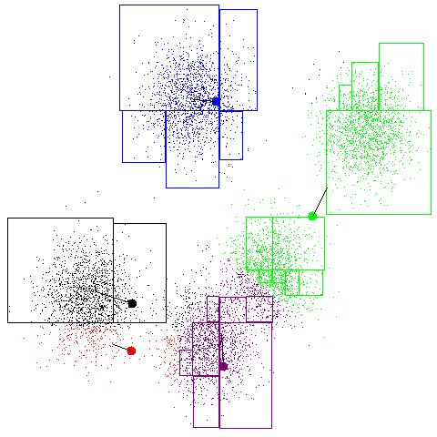
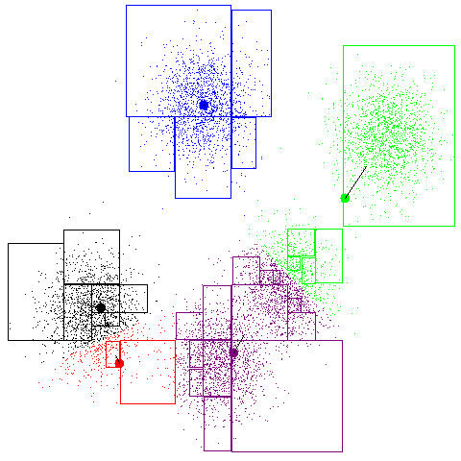
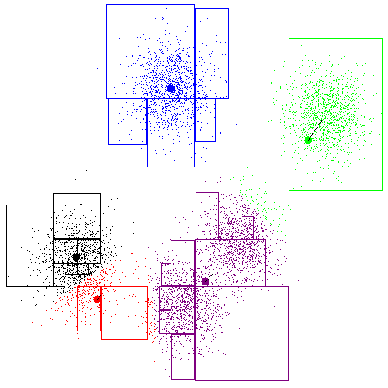
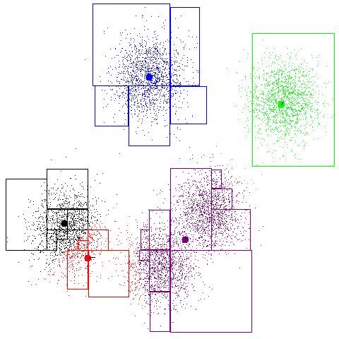
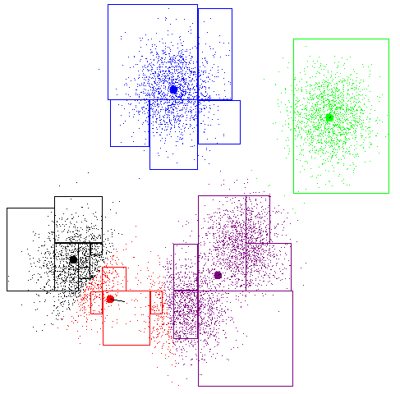
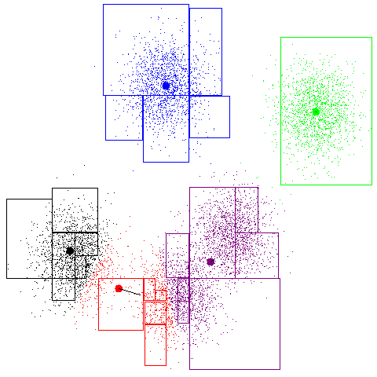
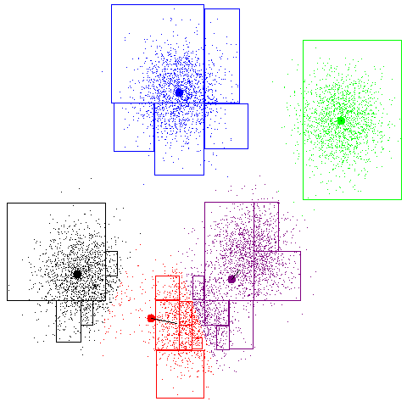
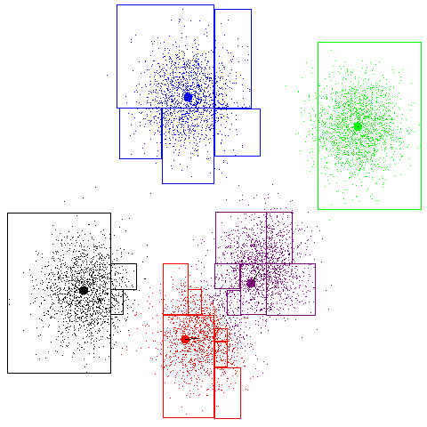
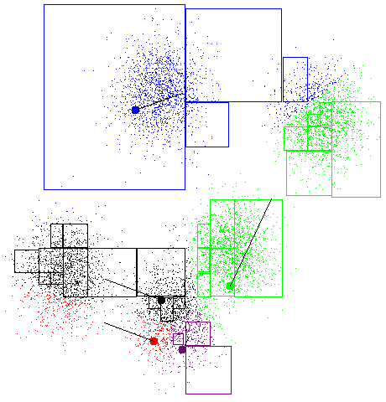
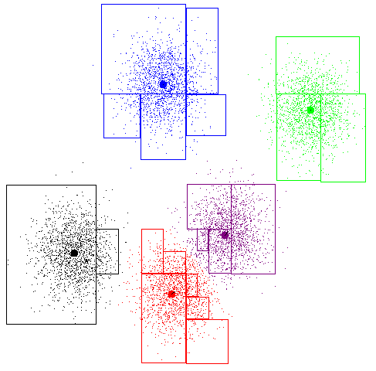
K-Means Example

Slide 26
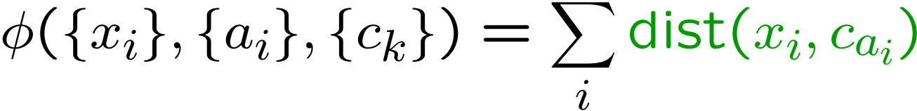
K-Means as Optimization
Consider the total distance to the means:
Each iteration reduces φ
Two stages each iteration:
Update assignments: fix means c,
change assignments a
Update means: fix assignments a,
change means c
points
means
assignments

Slide 27
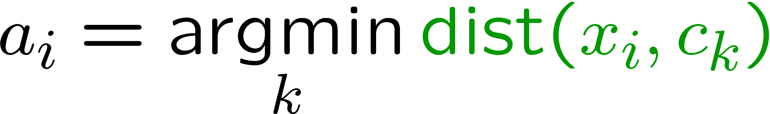

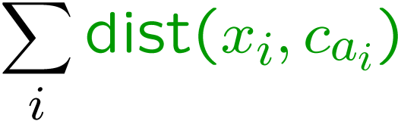
Phase I: Update Assignments
For each point, reassign to the closest mean:
Can only decrease total distance φ !

Slide 28
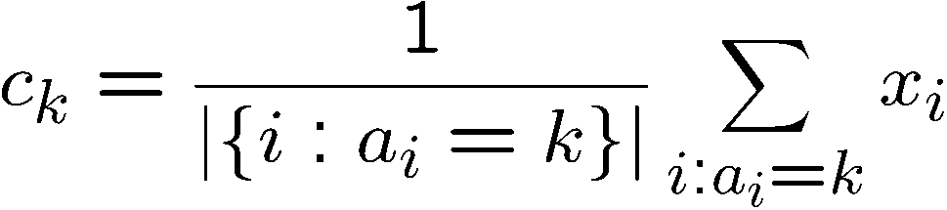
Phase II: Update Means
Move each mean to the average of its assigned points:
Also can only decrease total distance… (Why?)

Slide 29
Initialization
K-means is non-deterministic
Requires initial means
It does matter what you pick!
What can go wrong?
Various schemes for preventing this kind of thing: variance-based split / merge, initialization heuristics

Slide 30
K-Means Getting Stuck
A local optimum:
Why doesn’t this work out like the earlier example, with the purple taking over half the blue?

Slide 31
K-Means Questions
Will K-means converge?
To a global optimum?
Will it always find the true patterns in the data?
If the patterns are very very clear?
Will it find something interesting?
Do people ever use it?
How many clusters to pick?

Slide 32
Agglomerative Clustering
Agglomerative clustering:
First merge very similar instances
Incrementally build larger clusters out of smaller clusters
Algorithm:
Maintain a set of clusters
Initially, each instance in its own cluster
Repeat:
Pick the two closest clusters
Merge them into a new cluster
Stop when there’s only one cluster left
Produces not one clustering, but a family of clusters represented by a dendrogram

Slide 33
Agglomerative Clustering
How should we define “closest” for clusters with multiple elements?
Many options
Closest pair (single-link clustering)
Farthest pair (complete-link clustering)
Average of all pairs
Ward’s method (min variance, like k-means)
Different choices create different clustering behaviors

Slide 34

Clustering Application
Top-level categories: supervised classification
Story groupings:
unsupervised clustering

Slide 35
Clustering Algorithms (Review)
Naïve Bayes Model (AUTOCLASS)
Select M_{i} that has the best P(D|M_{i}),
K-Means
Loop until no improvement
Assign data to the nearest cluster
Adjust clusters to fit the assignments
Agglomerative
Always merge the pair of “closest” clusters

Slide 36
The EM Algorithm
It is not an “algorithm”, it is a Framework!
A loop of two phases
Estimation
Modification (Maximization)
For example, when we do clustering
Phase 1: update assignment (data to cluster)
Phase 2: update means (adjust clusters)

Slide 37
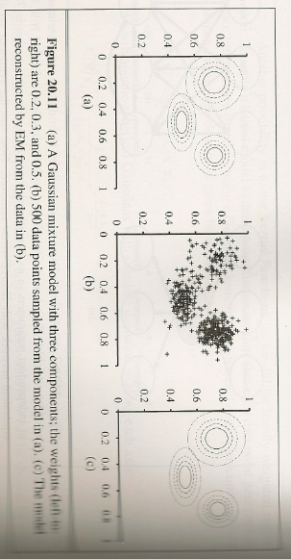
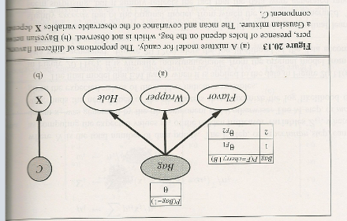
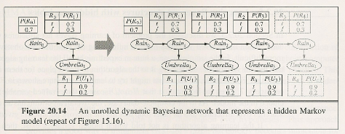
The EM Algorithm
A very general framework
Many forms & applications
Clustering with Gaussians
Bayesian net with hidden variables
Hidden Markov models (HMM)
Partially Observable Markov Decision Process (POMDP)
See e.g., ALFE 5.10
Others
We describe it by form/applications
Clustering
Learning POMDP ⬅

Slide 38

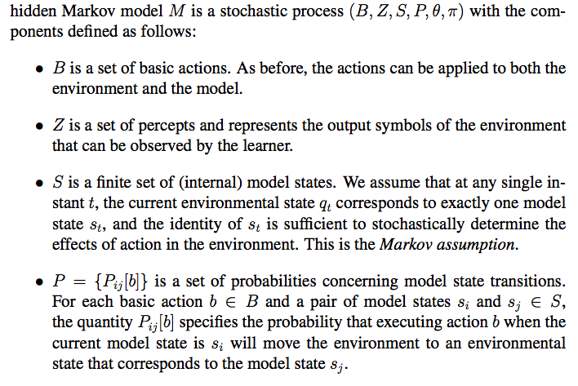
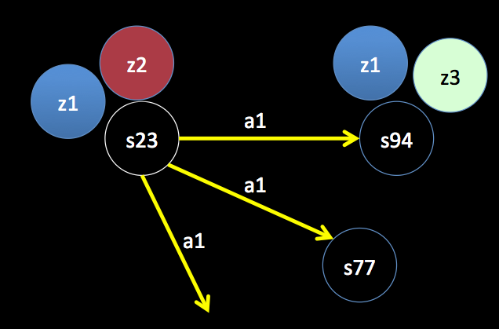
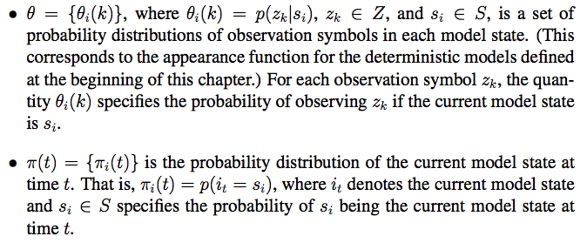
HMM/POMDP (A Review)
1. Actions
2. Percepts (observations)
3. States
4. Appearance: states → observations
5. Transitions: (states, actions) → states
6. Current State
Three key components:
- Sensor model θ=p(z|s)
- Action model P(s|s,a)
- Current state π_{t}(s) (localization)

Slide 39
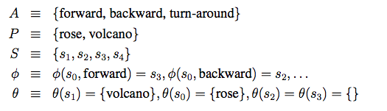
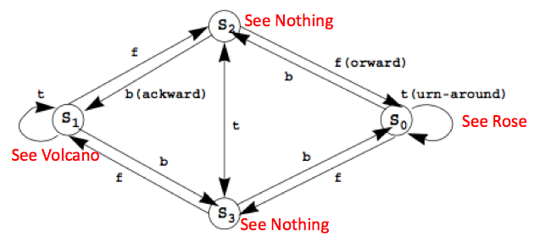
Little Prince Example
{P(s3|s0,f)=.51, P(s2|s1,b)=.32, P(s4|s3,t)=.89, …}
{P(rose|s0)=.76, P(volcano|s1)=.83, P(nothing|s3)=.42, …}

Slide 40

Learning HMM/POMDP
M = (B, Z, S, P, θ, π)
Task:
Given B, Z, S, and an experience
Improve P, θ, π.
“Improve” means better match the experience
How do we do that?
EM: Bayesian Again!
P(E|M): Use M to explain E
Use the explanation to improve P(M|E)

Slide 41
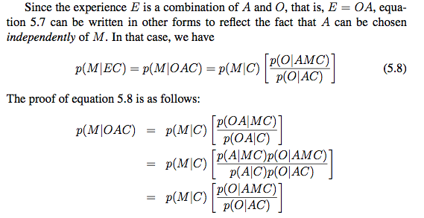
Equations for “Improving based on explanation”
Assume A and M
are independent: P(A|MC)=P(A|C)
improving
explanation

Slide 42
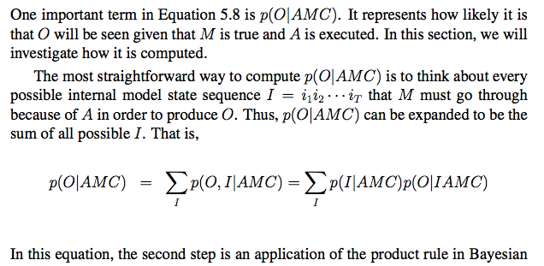
Compute Hidden State Sequence (1/2)
Experience consists of both O and A
O is observation sequence and A is action sequence in experience
M is the model, C is the background information
Little Prince Example: for three steps, how many possible I are there?

Slide 43
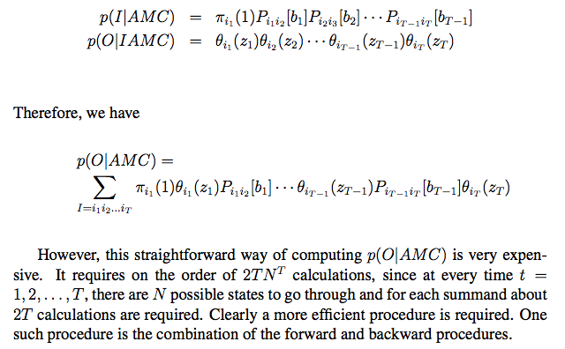
Compute Hidden State Sequence (2/2)
O = {z₁, z₂, …, z_{T}}, A = {b₁, b₂, …, b_{T}}, I = {i₁, i₁, …, i_{T}}
Among all possible sequences in I, there is one with the maximal probability.

Slide 44
Which Explanation is the best?
Among all possible sequences of states, the best “explanation” is the sequence of states that gives the maximal value for
Experience:
Observations: o₁, o₂, …, o_{T}
Actions: b₁, b₂, …, b_{T}
Sensor model:
Action model: P_{ij}[b] = P(s_{j} | s_{i}, b)
Explanation: State sequence: i₁, i₂, i₃, …, i_{T}

Slide 45
The EM Algorithm
E-Step: Estimate P(E|M) the likelihood of the experience E given the model M
Using the model M to explain the experience E
M-Step: Maximizing the parameters of the model M using the knowledge learned from the experience
Using the explanation to improve the model
E.g., Baum-Welch Learning Procedure

Slide 46
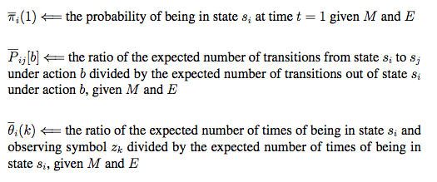
Baum-Welch Learning Procedure
Using the explanation of the experience to change the model:

Slide 47
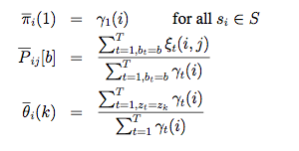

Update P, θ, π using α, β, γ, ξ
(Smooth) Use the whole experience to determine the beginning
From all s_{i}, how many go to s_{j}
From all s_{i}, how many look like z_{k}
(Smooth) Use the whole model
to determine the next state

Slide 48

Little Prince Example
Computing α, β, γ, ξ using the experience
E = {rose}, forward, {nothing}, forward, {volcano}
States: s₀, s₁, s₂, s₃
Init state distribution: 0.25, 0.25, 0.25, 0.25
Transitions: P( S_{j} | S_{i}, forward):
Observations Z=<rose, volcano, nothing>
Sensor model:
S₀ S₁ S₂ S₃
S₀ S₁ S₂ S₃
S₀ S₁ S₂ S₃

Slide 49
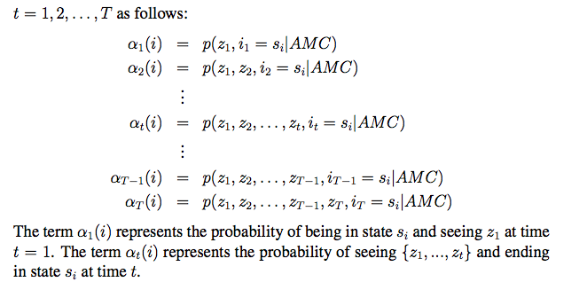

Forward Procedure
Compute step by step:
α_{t}(i): the probability at the state s_{i} at time t given E

Slide 50


Compute α values
α₁(s₃)=0.25*0.8=0.2
α₁(s₂)=0.25*0.5=0.125
α₁(s₁)=0.25*0.2=0.05
α₁(s₀)=0.25*0.4=0.1
α₂(s₃)=(.2*.1+.125*.1+.05*.1+.1*.4)*0.1
α₂(s₂)=(.2*.5+.125*.1+.05*.3+.1*.2)*0.2
α₂(s₁)=(.2*.3+.125*.3+.05*.3+.1*.1)*0.2
α₂(s₀)=(.2*.1+.125*.5+.05*.3+.1*.3)*0.1
S₀ S₁ S₂ S₃

Slide 51
Compute α values
α₁(s₃)=0.2
α₁(s₃)=0.125
α₁(s₁)=0.05
α₁(s₀)=0.1
α₂(s₃)=0.00775
α₂(s₂)=0.0295
α₂(s₁)=0.092
α₂(s₀)=0.0125
α₃(s₃)=(.00775*.1+.0295*.1+.092*.1+.0125*.4)*0.1
α₃(s₂)=(.00775*.5+.0295*.1+.092*.3+.0125*.2)*0.3
α₃(s₁)=(.00775*.3+.0295*.3+.092*.3+.0125*.1)*0.6
α₃(s₀)=(.00775*.1+.0295*.5+. .092*.3+.0125*.3)*0.5

Slide 52

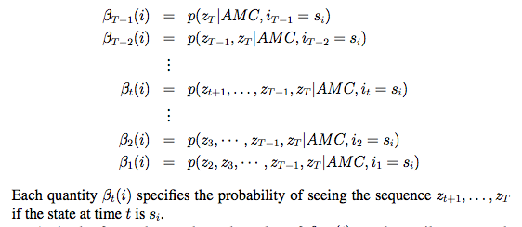
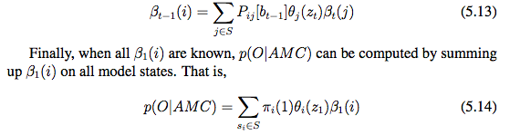
Compute β_{t}(i) by Backward Procedure
β_{t}(i): given E, the probability of being at the state s_{i} at time t

Slide 53

Compute β values
β₂(s₃)=(.1*.1+.5*.3+.3*.6+.1*.5)*1.0
β₂(s₂)=(.1*.1+.1*.3+.3*.6+.5*.5)*1.0
β₂(s₁)=(.1*.1+.3*.3+.3*.6+.3*.5)*1.0
β₂(s₀)=(.4*.1+.2*.3+.1*.6+.3*.5)*1.0
β₃(s₃)=1.0
β₃(s₂)=1.0
β₃(s₁)=1.0
β₃(s₀)=1.0
S₀ S₁ S₂ S₃

Slide 54
Compute β values
β₁(s₃) = fill in here in the class
β₁(s₂)=
β₁(s₁)=
β₁(s₀)=
β₂(s₃)=0.39
β₂(s₂)=0.47
β₂(s₁)=0.43
β₂(s₀)=0.31
β₃(s₃)=1.0
β₃(s₂)=1.0
β₃(s₁)=1.0
β₃(s₀)=1.0

Slide 55
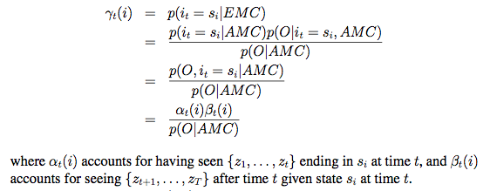
ϒ_{t}(i) Value: Putting α and β together
ϒ_{t}(i) is the probability of being at state s_{i} at time t given the entire experience E_{1:T}
S1 S2 S3 S4
S1 S2 S3 S4
S1 S2 S3 S4
S1 S2 S3 S4
s_{i}
t

Slide 56
Compute γ = α*β
γ₁(s₃)
γ₁(s₂)
γ₁(s₁)
γ₁(s₀)
γ₂(s₃)
γ₂(s₂)
γ₂(s₁)
γ₂(s₀)
γ₃(s₃)
γ₃(s₂)
γ₃(s₁)
γ₃(s₀)

Slide 57
Putting α and β together
α₁(s₃)=0.2
α₁(s₃)=0.125
α₁(s₁)=0.05
α₁(s₀)=0.1
β₁(s₃)
β₁(s₂)
β₁(s₁)
β₁(s₀)
α₂(s₃)=0.00775
α₂(s₂)=0.0295
α₂(s₁)=0.092
α₂(s₀)=0.0125
β₂(s₃)=0.39
β₂(s₂)=0.47
β₂(s₁)=0.43
β₂(s₀)=0.31
α₃(s₃)=.0017925
α₃(s₂)=.0110775
α₃(s₁)=.024015
α₃(s₀)=.0234375
β₃(s₃)=1.0
β₃(s₂)=1.0
β₃(s₁)=1.0
β₃(s₀)=1.0

Slide 58
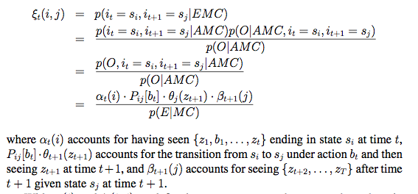
ξ_{t}(i,j) Value
ξ_{t}(i,j) is the probability of making transition from s_{i} to s_{i} at time t in the experience E_{1:T}
S1 S2 S3 S4
S1 S2 S3 S4
S1 S2 S3 S4
S1 S2 S3 S4
s_{i}
b_{t}
s_{j}
t t+1

Slide 59
Example ξ value
ξ₁(s_{i},s_{j}) =
α₁(s₃)=0.2
P(s₂|s₃)=0.3
α₁(s₃)=0.2
α₁(s₂)=0.125
α₁(s₁)=0.05
α₁(s₀)=0.1
β₂(s₃)=0.39
β₂(s₂)=0.49
β₂(s₁)=0.43
β₂(s₀)=0.31
α₃(s₃)=.0017925
α₃(s₂)=.0110775
α₃(s₁)=.024015
α₃(s₀)=.0234375
θ_{s2}(nth)=0.2
β₂(s₂)=0.47

Slide 60
Improve the model by explanation Update P, θ, π using α, β, γ, ξ
Use the whole experience to determine the beginning
From all s_{i} in E, how many go to s_{j}
From all s_{i} in E, how many appear as z_{k}
Use the whole experience to determine
the distribution for the next state

Slide 61
The General EM Algorithm
E-Step: Estimate P(E|M) the likelihood of the experience E given the model M
E.g., computing α, β, γ, ξ using the experience
K-means: assigning data to the (closest) clusters
M-Step: Maximize the parameters of the model M using the knowledge (e.g., explanations) learned from the experience
E.g., update P, θ, π using α, β, γ, ξ
K-means: move the clusters based on the assignments

Slide 62
Comments on EM
The most general and powerful learning method
Many existing algorithms are special cases of EM
Tremendous application potentials
Robot navigation, localization, mapping, SLAM, manipulation, planning, etc.
Natural language processes (IBM’s Watson)
Data Mining
Gaming that can improve themselves
Discovering patterns from genetic and health data

